Slide 1
PhpStorm interpreter
Guide 02

Slide 2
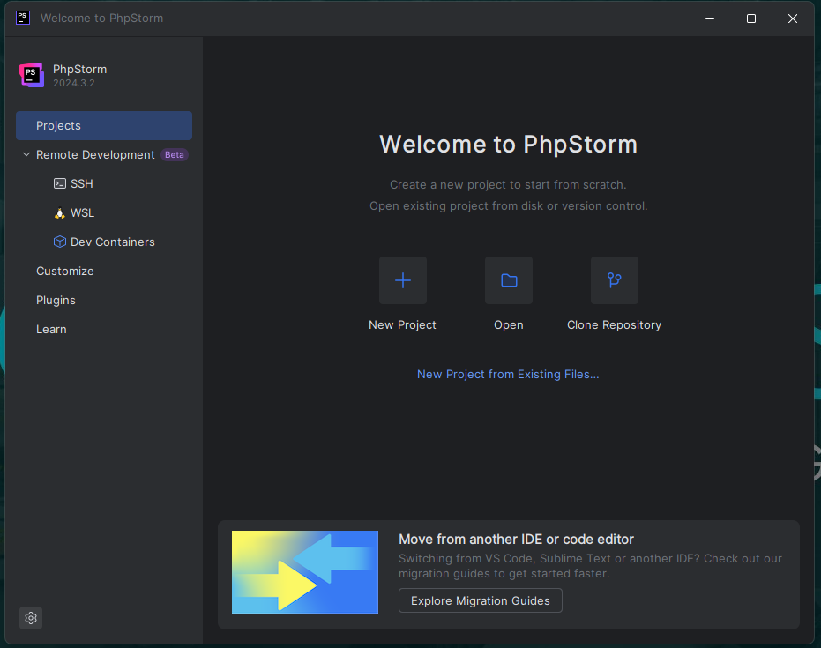
Open Settings
Open settings
from here

Slide 3
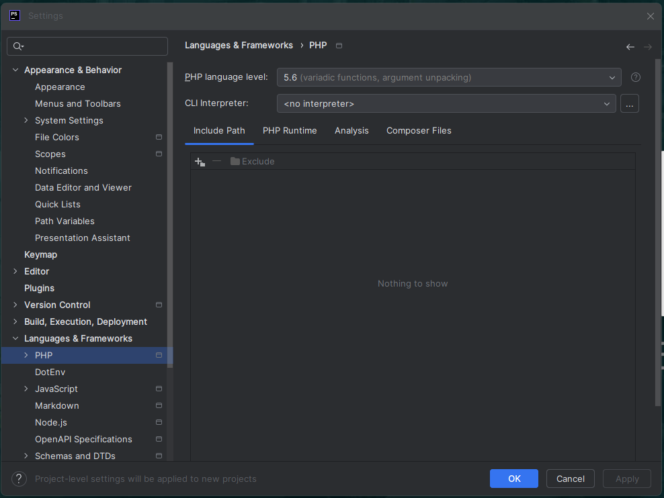
Navigate to PHP screen
Under "Languages & Frameworks"
Click "PHP" to get this
screen
2. Then click the 3 dots

Slide 4
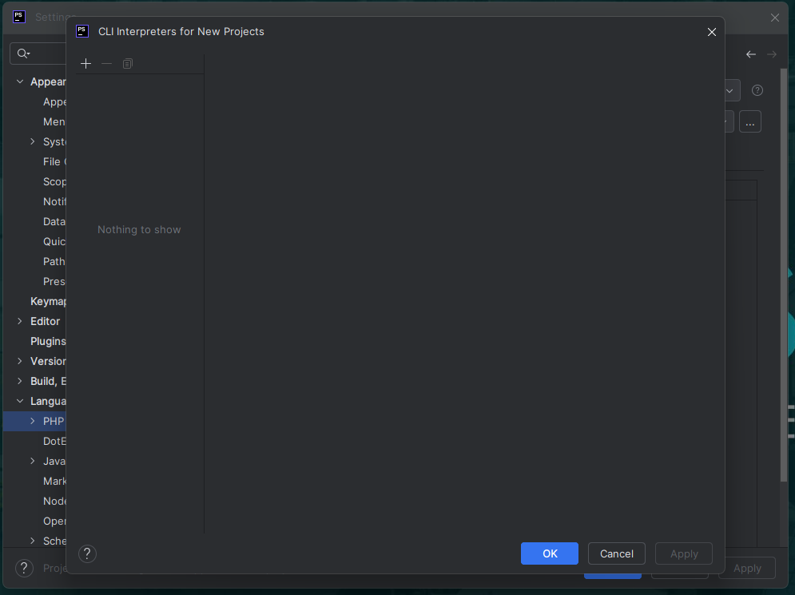
Add the Laragon interpreter
Click on the "+" button

Slide 5
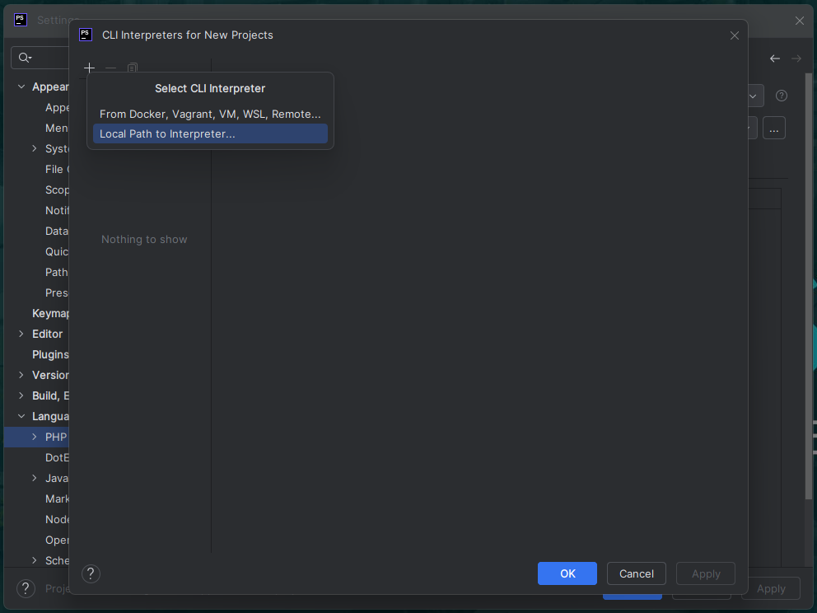
Local path to interpreter
Click this option

Slide 6
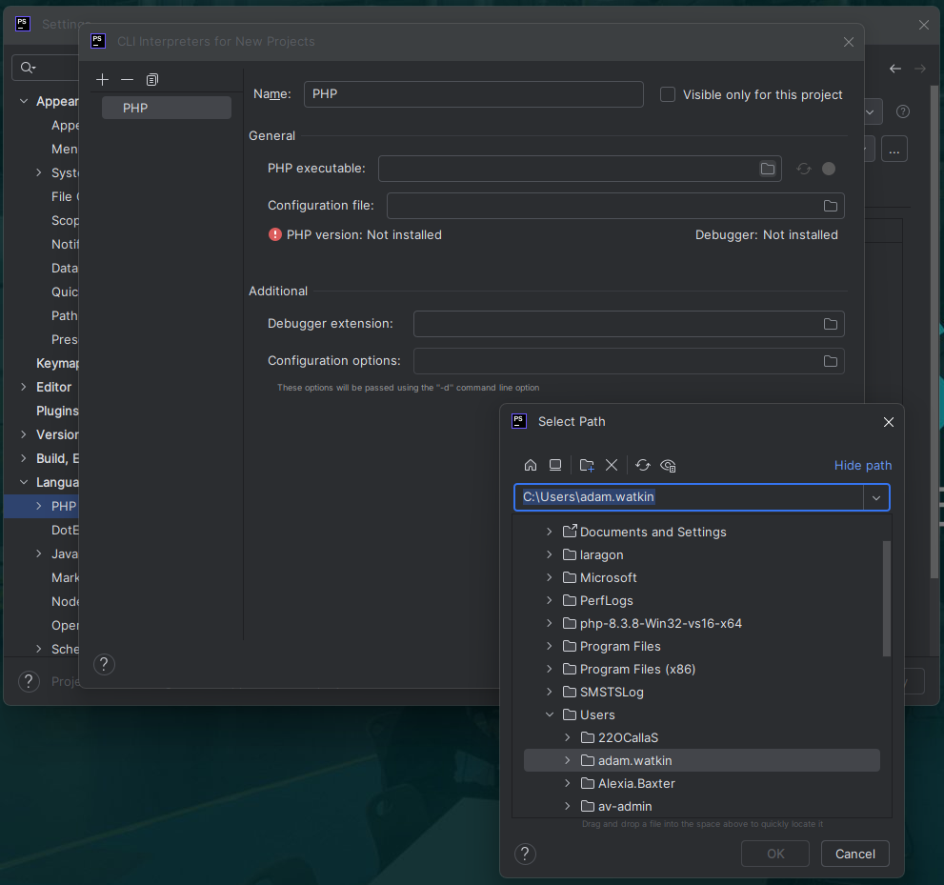
Open the file browser
Click here to open the "Select
Path" window

Slide 7
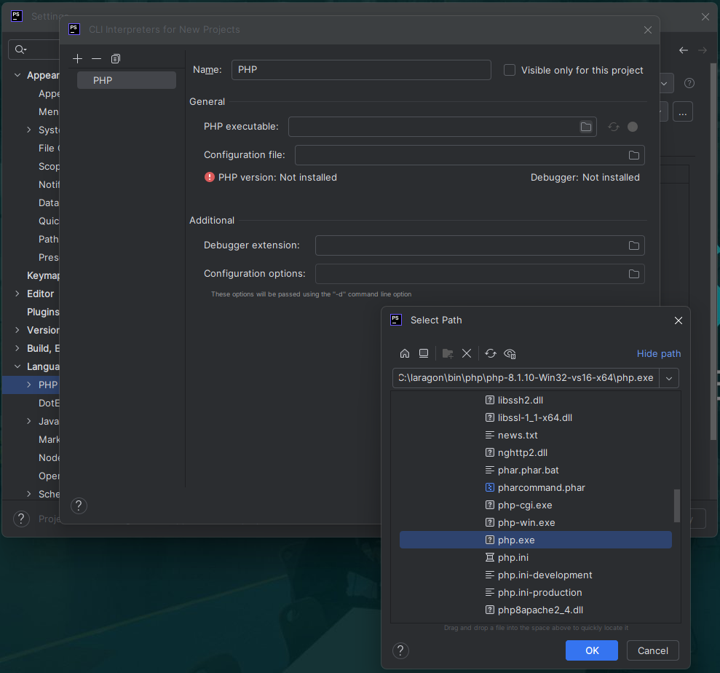
Locate the exe
Navigate here:
C:\laragon\bin\php\php-8.1.10-Win32-vs16-x64\php.exe
Click ok

Slide 8
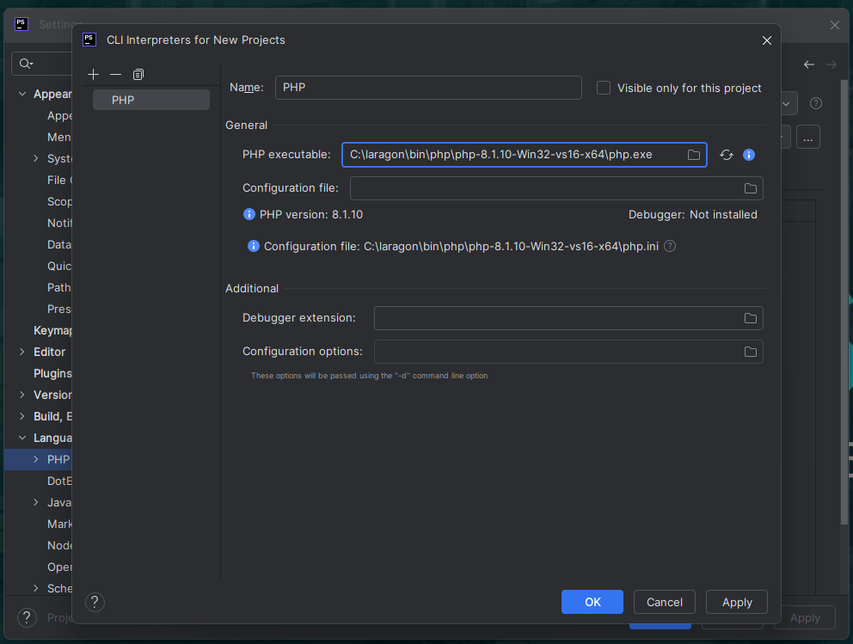
Apply and ok
Once the executable
appears here, click
"Apply" and then "ok"
Then close settings and
You are ready to code.

